Slide 1


Introduction to Machine Learning
DBDA.X408.(33)
Instructor:
Bill Chen
UCSC Silicon Valley Extension
E: xch375@ucsc.edu

Slide 2
Week 5
Decision Tree.
Boosting.
Support Vector Machines.
Colab Demonstration.
Slides were modified from CS239 Stanford

Slide 3
Decision Tree

Slide 4



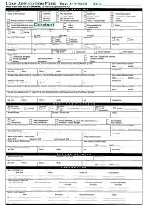




What makes a loan risky?
I want a to buy a new house!
Credit History
★★★★
Income
★★★
Term
★★★★★
Loan
Application
Personal Info
★★★

Slide 5
Credit history explained
Did I pay previous loans on time?
Credit History
★★★★
Example: excellent, good, or fair
Income
★★★
Term
★★★★★
Personal Info
★★★

Slide 6
Credit history explained
Credit History
★★★★
Income
★★★
What’s my income?
Example:
$80K per year
Term
★★★★★
Personal Info
★★★

Slide 7
Credit history explained
Credit History
★★★★
Income
★★★
How soon do I need to pay the loan?
Term
★★★★★
Example: 3 years,
5 years,…
Personal Info
★★★

Slide 8
Credit history explained
Credit History
★★★★
Income
★★★
Term
★★★★★
Age, reason for the loan, marital status,…
Personal Info
★★★
Example: Home loan for a married couple

Slide 9

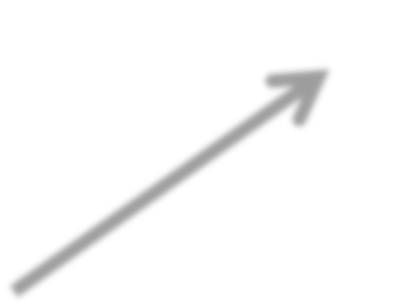



Classifier Review
Output: ŷ Predicted class
ŷ_{i} = +1
Safe
Loan Application
Classifier MODEL
Risky
Input: x_{i}
ŷ_{i} = -1

Slide 10
Decision Tree
Start
excellent
poor
Credit?
fair
Safe
Term?
Income?
high
Low
3 years
5 years
Risky
Safe
Term?
Risky
3 years
5 years
Risky
Safe

Slide 11
Decision Tree
x_{i} = (Credit = poor, Income = high, Term = 5 years)
Start
excellent
poor
Credit?
fair
Safe
Term?
Income?
high
Low
3 years
5 years
Risky
Safe
Term?
Risky
3 years
5 years
Risky
Safe
ŷ_{i} = Safe

Slide 12









Decision Tree Learning Problem
Training data: N observations (x_{i}, y_{i})
Credit | Term | Income | y
excellent | 3 yrs | high | safe
fair | 5 yrs | low | risky
fair | 3 yrs | high | safe
poor | 5 yrs | high | risky
excellent | 3 yrs | low | risky
fair | 5 yrs | low | safe
poor | 3 yrs | high | risky
poor | 5 yrs | low | safe
fair | 3 yrs | high | safe
T(X)
Optimize quality metric on training data

Slide 13
Quality Metric: Classification error
Error measures fraction of mistakes:
Error = # incorrect predictions / # example
Best possible value : 0.0
Worst possible value: 1.0

Slide 14
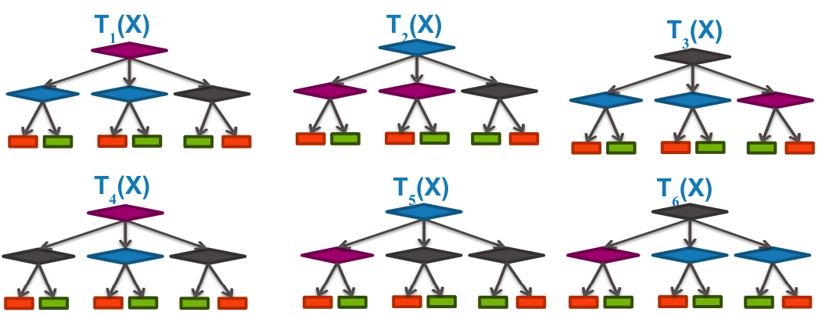
How do we find the best tree?
Exponentially large number of possible trees makes decision tree learning hard!
Learning the smallest decision tree is an NP-hard problem [Hyafil & Rivest ’76]

Slide 15
Greedy Decision Tree Learning

Slide 16
Our Training Data Table
Assume N = 40, 3 features
Credit | Term | Income | y
excellent | 3 yrs | high | safe
fair | 5 yrs | low | risky
fair | 3 yrs | high | safe
poor | 5 yrs | high | risky
excellent | 3 yrs | low | risky
fair | 5 yrs | low | safe
poor | 3 yrs | high | risky
poor | 5 yrs | low | safe
fair | 3 yrs | high | safe

Slide 17
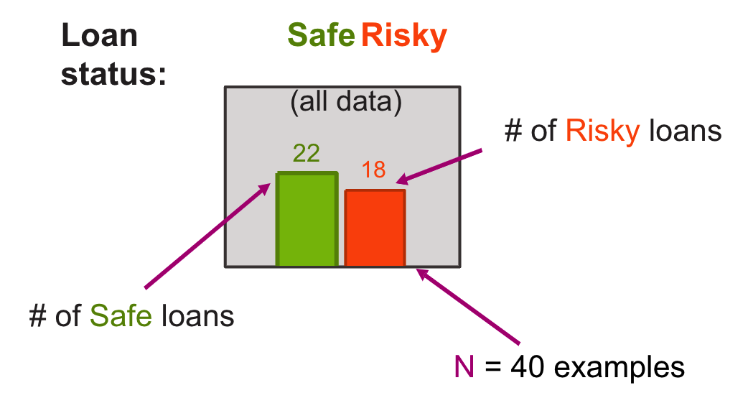
Start With All The Data

Slide 18
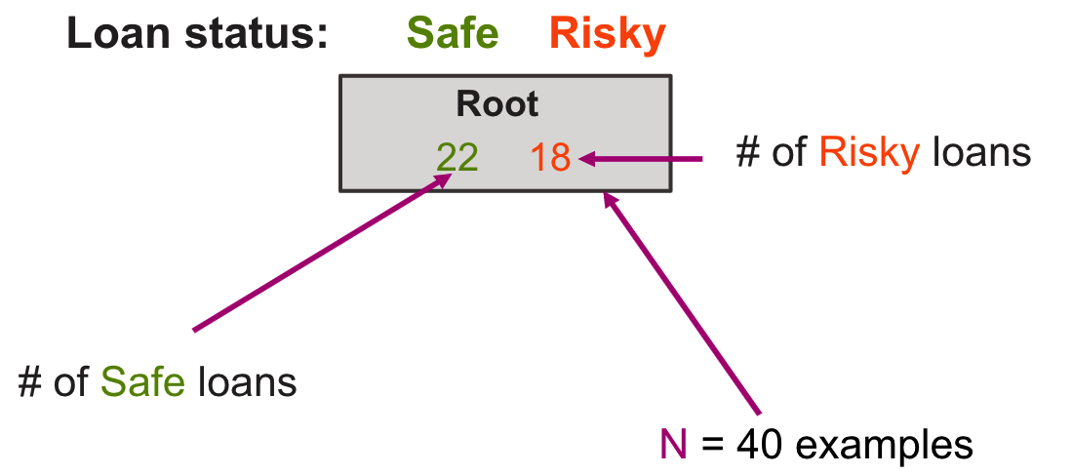
Compact Visual Notation: Root Node

Slide 19
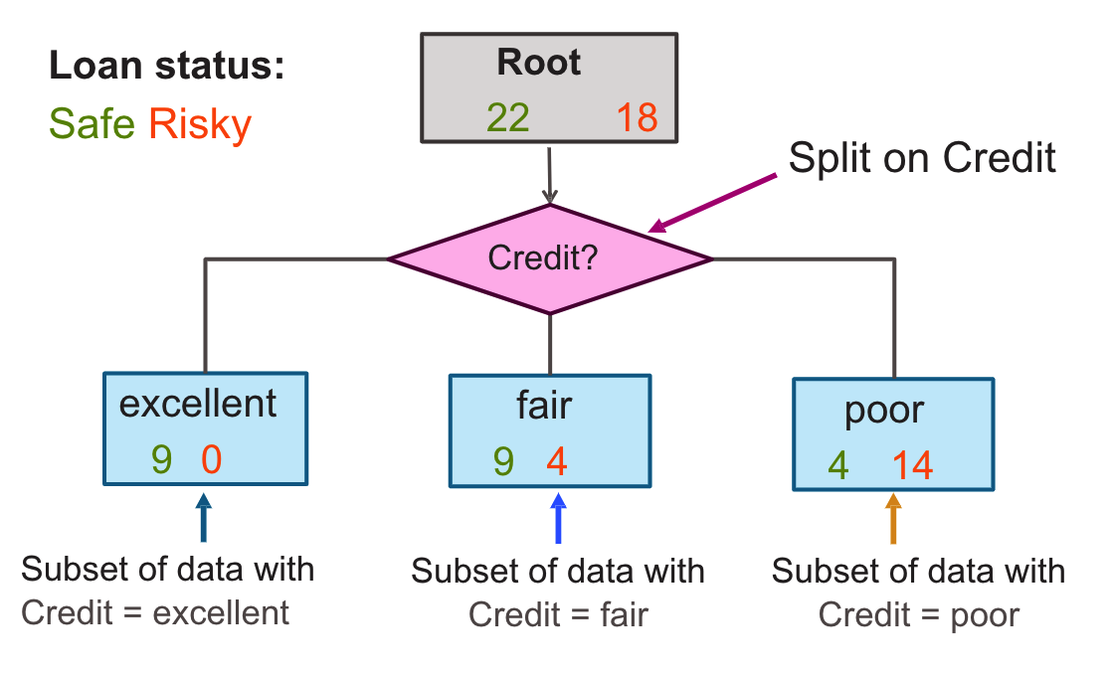
Decision Stump: Single Level Lree

Slide 20
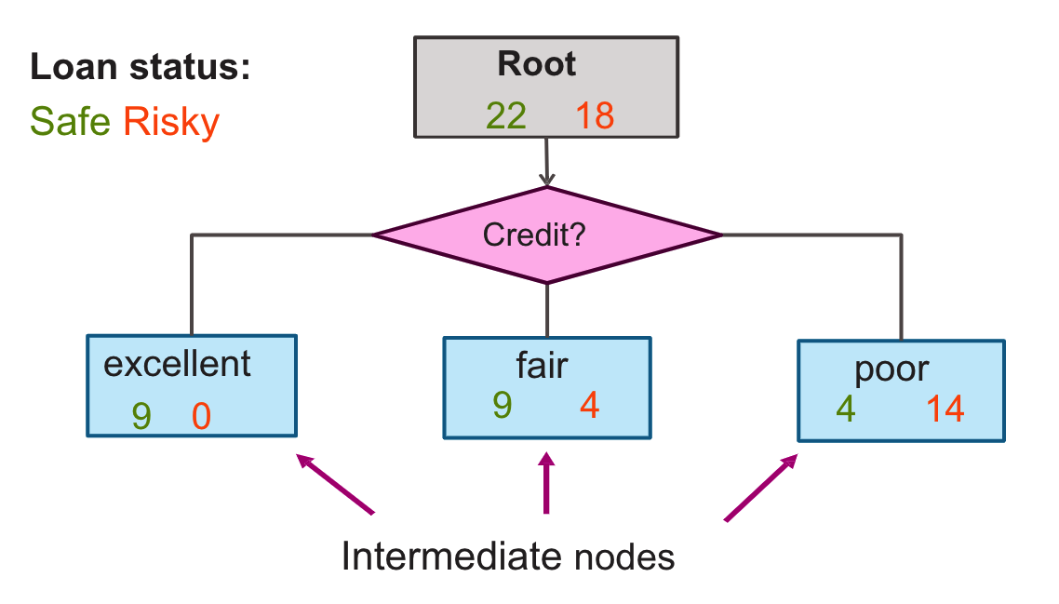
Visual Notation: Intermediate Nodes

Slide 21
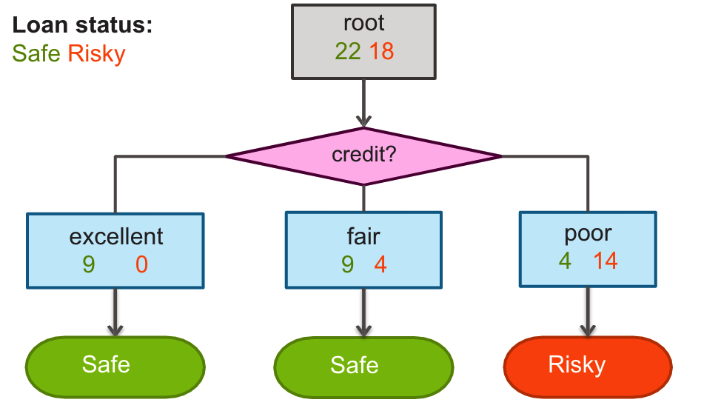
Making Predictions With a Decision Stump
For each intermediate node, set ŷ = majority value

Slide 22
Selecting The Best Feature To Split On

Slide 23
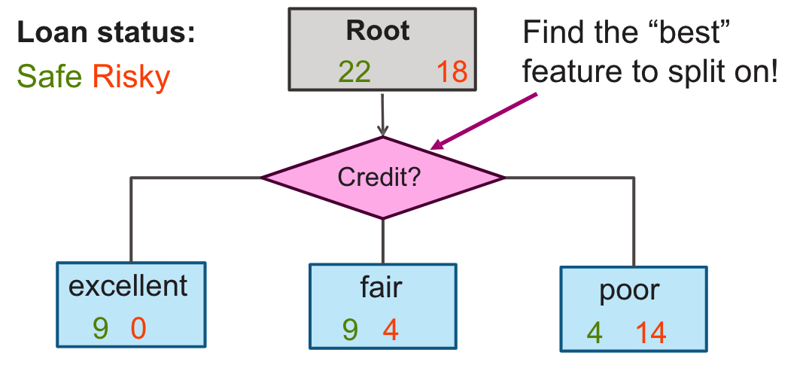
How do we learn a decision stump?

Slide 24


How do we select the best feature?
Choice 1: Split on Credit
Choice 2: Split on Term
Loan status:
Safe Risky
Root
22 18
Loan status:
Safe Risky
Root
22 18
OR
Credit?
Term?
excellent
9 0
fair
9 4
poor
4 14
3 years
16 4
5 years
6 14

Slide 25
How do we select the best feature?
Choice 1: Split on Credit
Choice 2: Split on Term
Loan status:
Safe Risky
Root
22 18
Loan status:
Safe Risky
Root
22 18
OR
Credit?
Term?
excellent
9 0
fair
9 4
poor
4 14
3 years
16 4
5 years
6 14

Slide 26
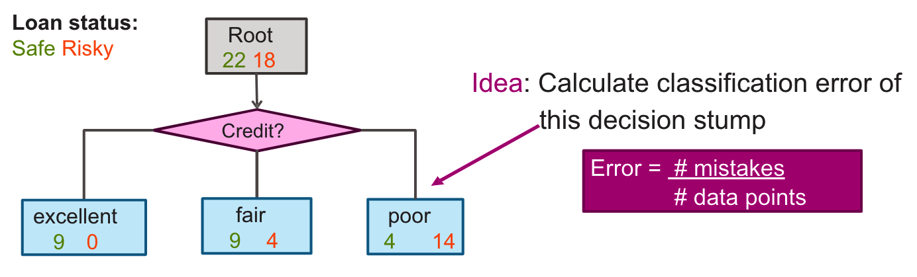
How do we measure effectiveness of a split?

Slide 27
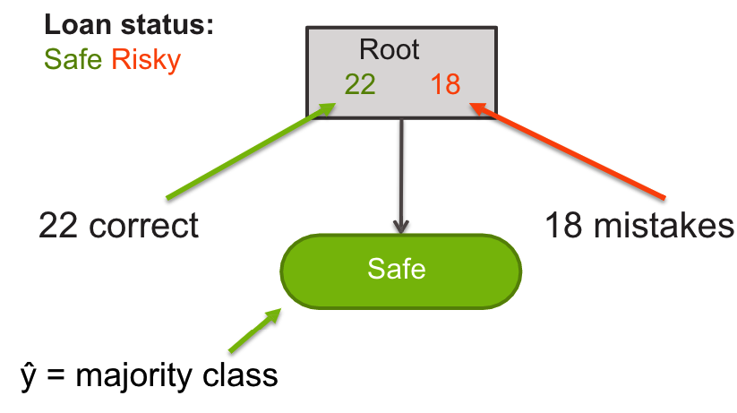
Calculating Classification Error
Step 1: ŷ = class of majority of data in node
Step 2: Calculate classification error of predicting ŷ for this data
Tree | Classification error
(root) | 0.45
How to do the calculation?

Slide 28
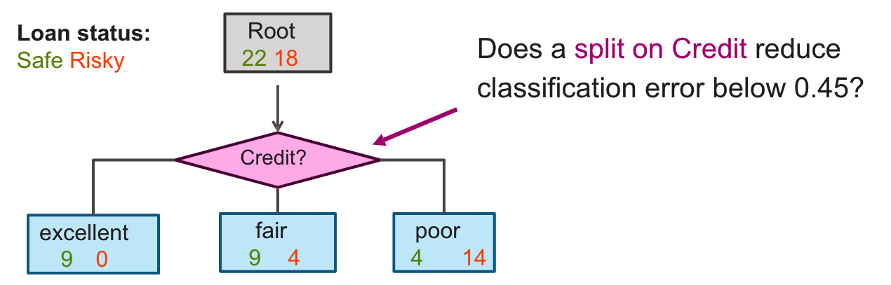
Choice 1: Split on Credit history?

Slide 29
Choice 1: Split on Credit history?
Tree | Classification error
(root) | 0.45
Split on credit | 0.2

Slide 30
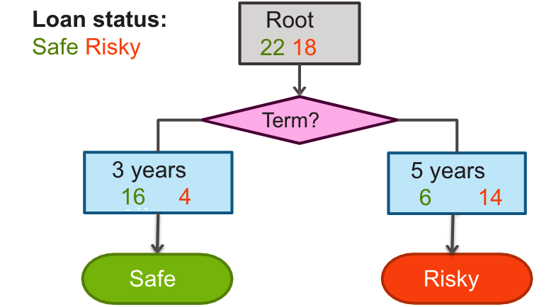
Choice 2: Split on Term?

Slide 31
Choice 2: Split on Term?
Tree | Classification error
(root) | 0.45
Split on credit | 0.2
Split on term | 0.25

Slide 32
Choice 1 or Choice 2?
Tree | Classification error
(root) | 0.45
Split on credit | 0.2
Split on term | 0.25
Choice 1: Split on Credit
Choice 2: Split on Term
Loan status:
Safe Risky
Root
22 18
Loan status:
Safe Risky
Root
22 18
OR
Credit?
Term?
excellent
9 0
fair
9 4
poor
4 14
3 years
16 4
5 years
6 14

Slide 33
Feature Split Selection Algorithm
Given a subset of data M (a node in a tree)
For each feature h_{i}(x):
Split data of M according to feature h_{i}(x)
Compute classification error of split
Chose feature h*(x) with lowest classification error

Slide 34
Recursion & Stopping conditions

Slide 35
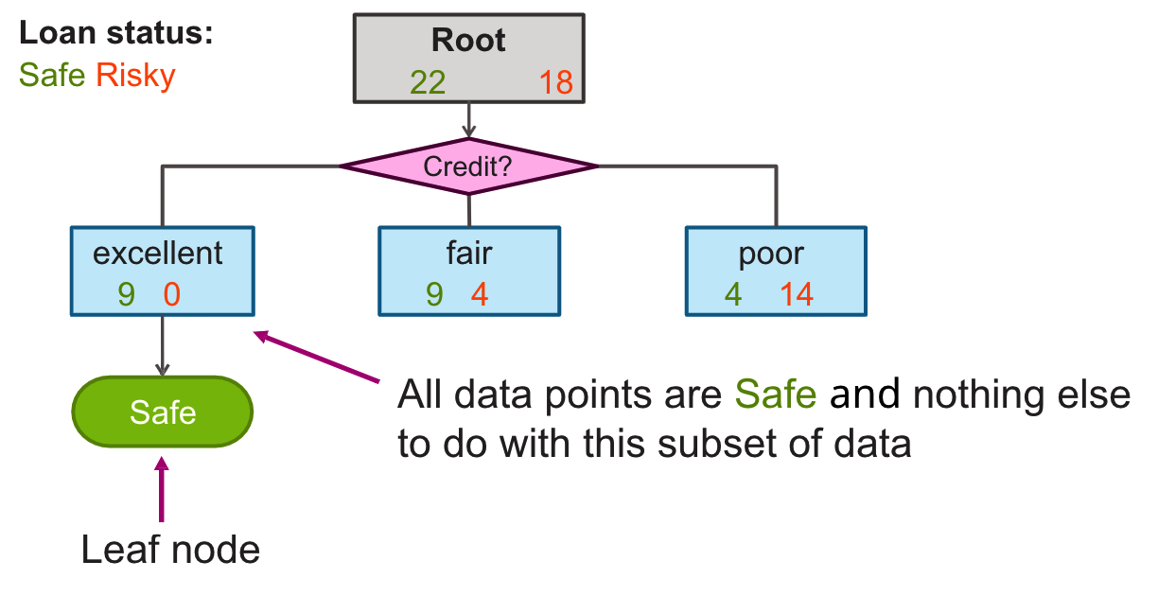
Can We Reuse The Data After Split?

Slide 36
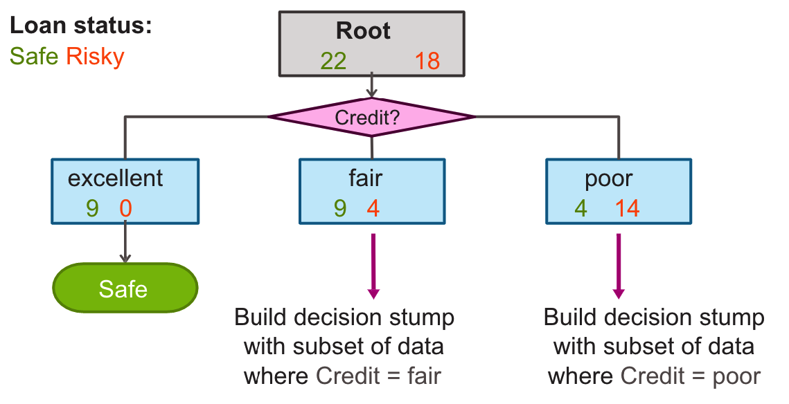
Tree Learning = Recursive Stump Learning

Slide 37
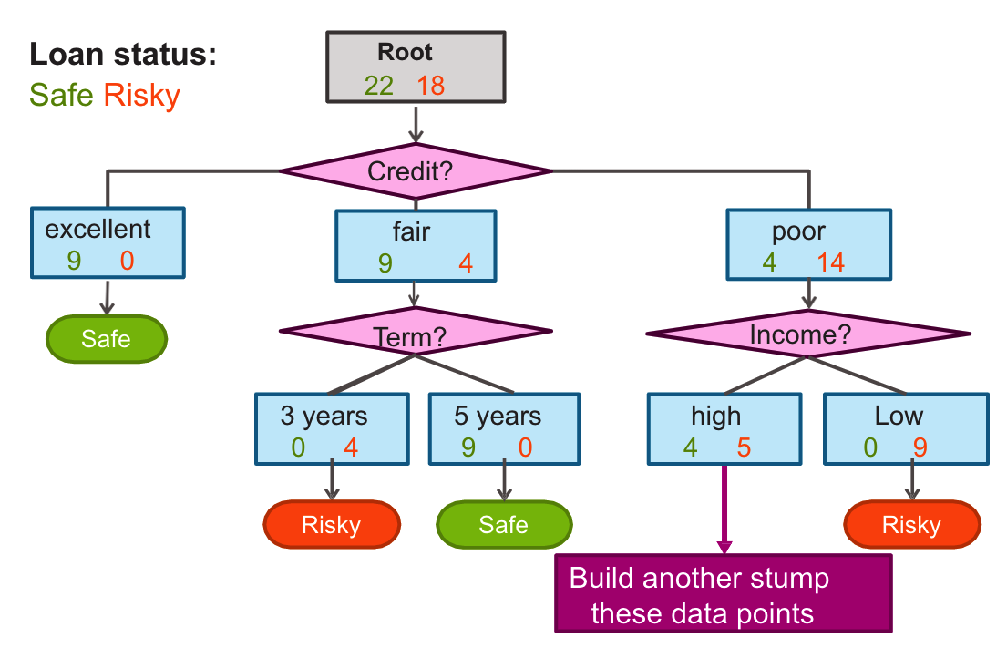
Second Level

Slide 38
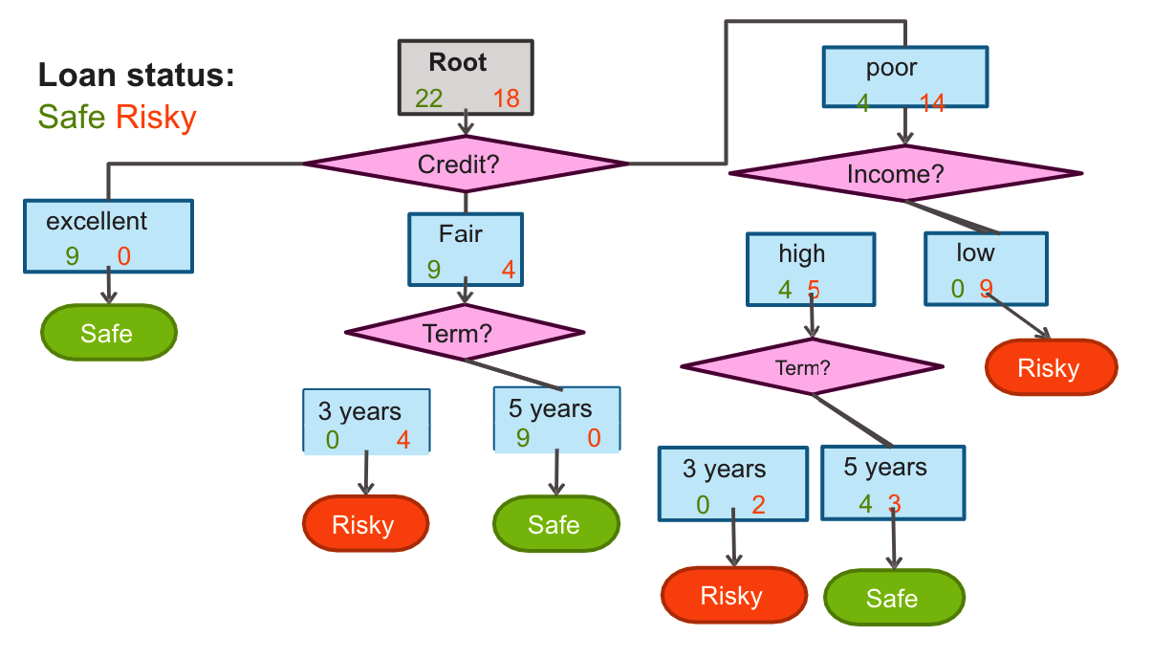
Final Decision Tree

Slide 39
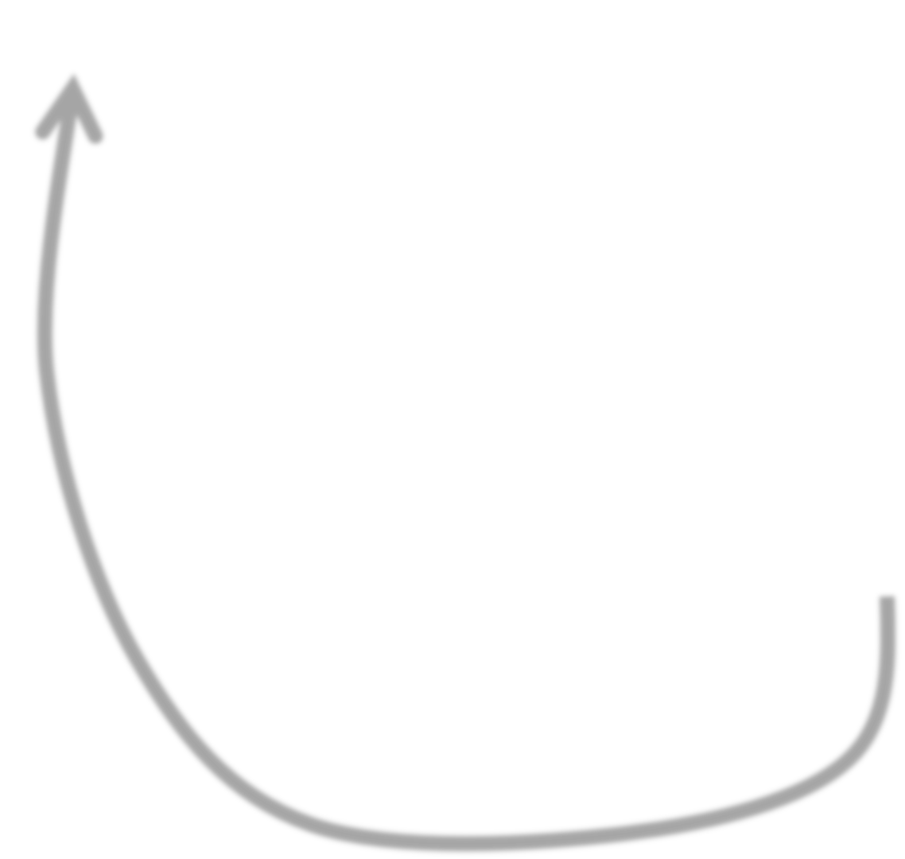
Simple greedy decision tree learning
Pick best feature to split on
Learn decision stump with this split
For each leaf of decision stump, recurse
When do we stop???

Slide 40
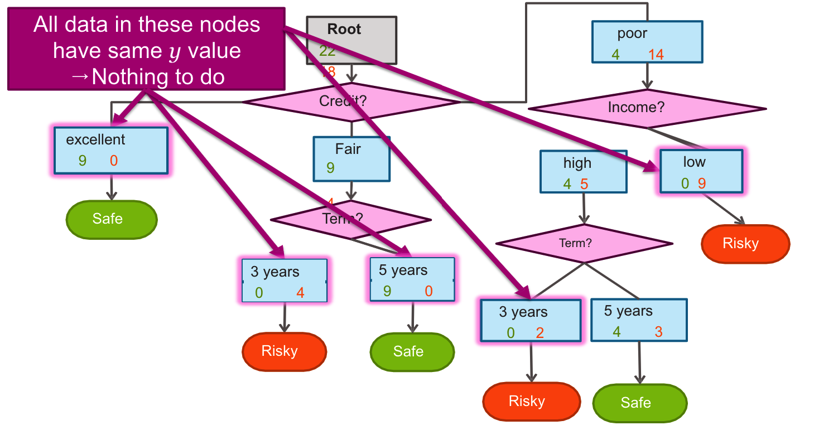
Stopping Condition 1: All Data Agrees On y

Slide 41
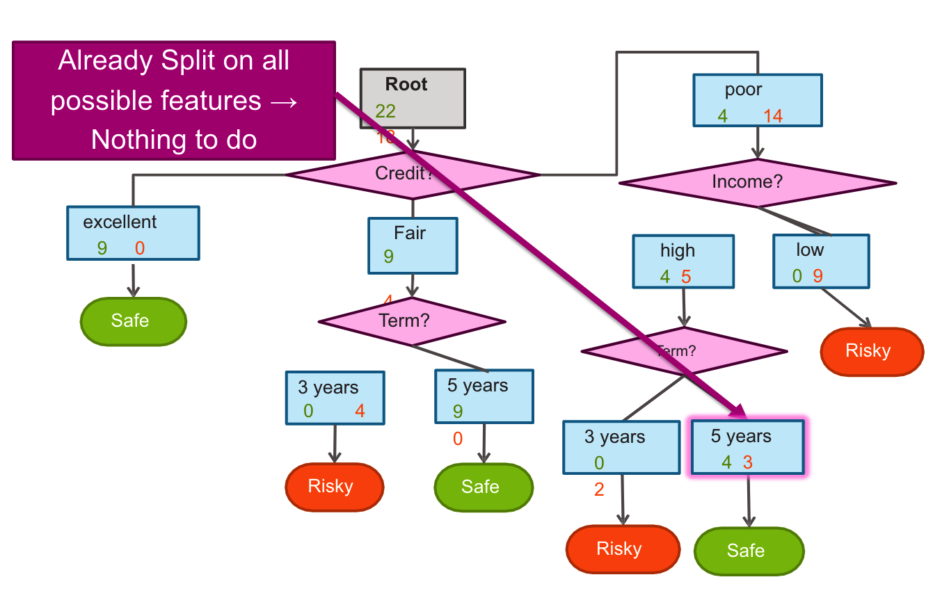
Stopping Condition 2: Already Split On All Features

Slide 42
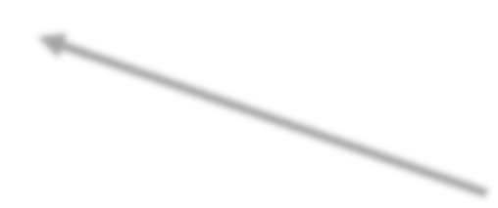


Greedy Decision Tree Learning
Step 1: Start with an empty tree
Step 2: Select a feature to split data
For each split of the tree:
Step 3: If nothing more to do, make predictions
Step 4: Otherwise, go to Step 2 & continue (recurse) on this split
Pick feature split leading to lowest classification error
Stopping conditions
Recursion

Slide 43
Is This a Good Idea?
Proposed stopping condition 3: Stop if no split reduces the classification error

Slide 44
Stopping condition 3: Don’t stop if error doesn’t decrease???
y values
True False
Root
2 2
y = x_{[1]} xor x_{[2]}
x[1] | x[2] | y
False | False | False
False | True | True
True | False | True
True | True | False
Tree | Classification error
(root) | 0.5

Slide 45
Consider Split On x_{[1]}
y values
True False
Root
2 2
y = x_{[1]} xor x_{[2]}
x[1] | x[2] | y
False | False | False
False | True | True
True | False | True
True | True | False
x[1]
True
1 1
False
1 1
Tree | Classification error
(root) | 0.5
Split on x[1] | 0.5

Slide 46


Consider Split On x_{[2]}
y values
True False
Root
2 2
y = x_{[1]} xor x_{[2]}
x[1] | x[2] | y
False | False | False
False | True | True
True | False | True
True | True | False
x[2]
True
1 1
False
1 1
Neither features improve training error… Stop now???
Tree | Classification error
(root) | 0.5
Split on x[1] | 0.5
Split on x[2] | 0.5

Slide 47
Consider Split On x_{[2]}
y values
True False
Root
2 2
y values
True False
Root
2 2
y = x_{[1]} xor x_{[2]}
x[1] | x[2] | y
False | False | False
False | True | True
True | False | True
True | True | False
x[1]
x[2]
True
1 1
False
1 1
True
1 1
False
1 1
Neither features improve training error… Stop now???
Tree | Classification error
(root) | 0.5
Split on x[1] | 0.5
Split on x[2] | 0.5

Slide 48
Final Tree With Stopping Condition 3
y values
True False
Root
2 2
y = x_{[1]} xor x_{[2]}
x[1] | x[2] | y
False | False | False
False | True | True
True | False | True
True | True | False
Predict True
Tree | Classification error
with stopping condition 3 | 0.5

Slide 49
Without Stopping Condition 3
Condition 3 (stopping when training error doesn’t’ improve) is not recommended!
y values
True False
Root
2 2
y = x_{[1]} xor x_{[2]}
x[1] | x[2] | y
False | False | False
False | True | True
True | False | True
True | True | False
x[1]
True
1 1
False
1 1
Predict True
x[2]
x[2]
Tree | Classification error
with stopping condition 3 | 0.5
without stopping condition 3
True
0 1
False
1 0
True
1 0
False
0 1
False
True
True
False

Slide 50
Decision Tree Learning: Real Valued Features

Slide 51
How Do We Use Real Values Inputs?
Income | Credit | Term | y
$105 K | excellent | 3 yrs | Safe
$112 K | good | 5 yrs | Risky
$73 K | fair | 3 yrs | Safe
$69 K | excellent | 5 yrs | Safe
$217 K | excellent | 3 yrs | Risky
$120 K | good | 5 yrs | Safe
$64 K | fair | 3 yrs | Risky
$340 K | excellent | 5 yrs | Safe
$60 K | good | 3 yrs | Risky

Slide 52
Threshold Split
Loan status:
Safe Risky
Root
22 18
Split on the feature Income
Income?
< $60K
8 13
>= $60K
14 5
Subset of data with
Income >= $60K

Slide 53









Finding The Best Threshold Split
Infinite possible values of t
Income = t*
Income < t*
Income >= t*
Safe Risky
Income

Slide 54
Only Need To Consider Mid-points
Finite number of splits to consider
Income
$10K

Slide 55
Threshold split selection algorithm
Step 1: Sort the values of a feature h_{j}(x) :
Let {v₁, v₂, v₃, … v_{N}} denote sorted values
Step 2:
For i = 1 … N-1
Consider split t_{i} = (v_{i} + v_{i+1}) / 2
Compute classification error for threshold split h_{j}(x) >= t_{i}
Chose the t* with the lowest classification error

Slide 56


Visualizing the threshold split
Income
Threshold split is the line Age = 38
…
$80K
$40K
$0K
Age
0
10
20
30
40
…

Slide 57
Split on Age >= 38
Income
age < 38
age >= 38
Predict Risky
…
$80K
$40K
Predict Safe
$0K
Age
0
10
20
30
40
…

Slide 58
Depth 2: Split on Income >= $60K
Threshold split is the line Income = 60K
Income
…
$80K
$40K
$0K
Age
0
10
20
30
40
…

Slide 59
Each split partitions the 2-D space
Income
Age >= 38
Income >= 60K
Age < 38
…
$80K
$40K
Age >= 38
Income < 60K
$0K
Age
0
10
20
30
40
…

Slide 60
Decision trees vs logistic regression:
Example

Slide 61
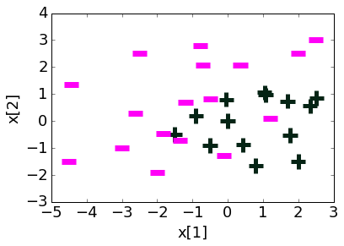
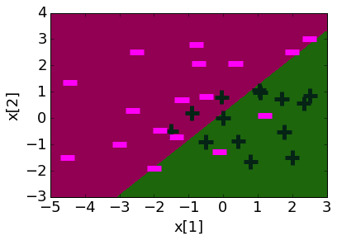
Logistic Regression
Feature | Value | Weight Learned
h₀(x) | 1 | 0.22
h₁(x) | x[1] | 1.12
h₂(x) | x[2] | -1.07

Slide 62
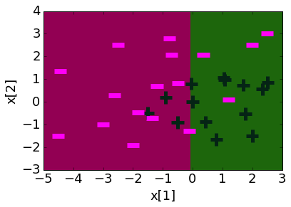
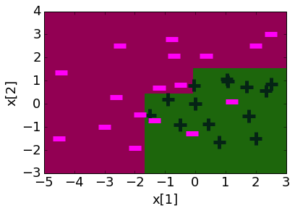
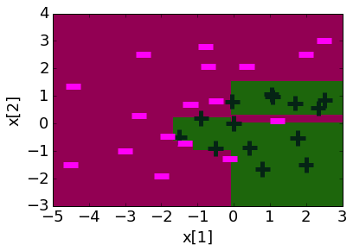
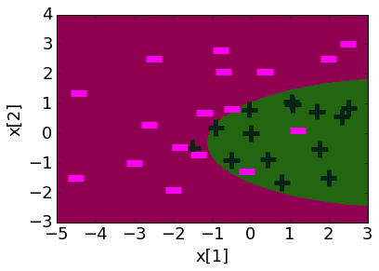
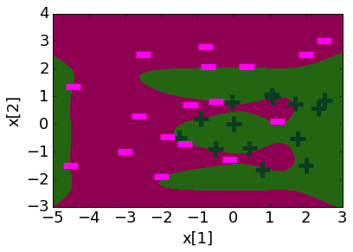
Comparing decision boundaries
Decision Tree
Depth 1
Depth 3
Depth 10
Logistic Regression
Degree 1 features
Degree 2 features
Degree 6 features

Slide 63
What you can do now
Define a decision tree classifier
Interpret the output of a decision trees
Learn a decision tree classifier using greedy algorithm
Traverse a decision tree to make predictions
Majority class predictions
Tackle continuous and discrete features

Slide 64
Boosting

Slide 65
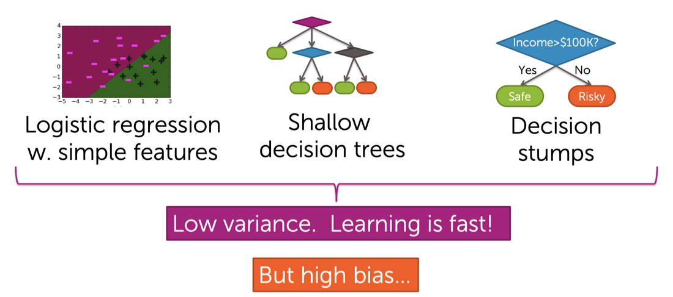
Simple (Weak) Classifiers Are Good

Slide 66
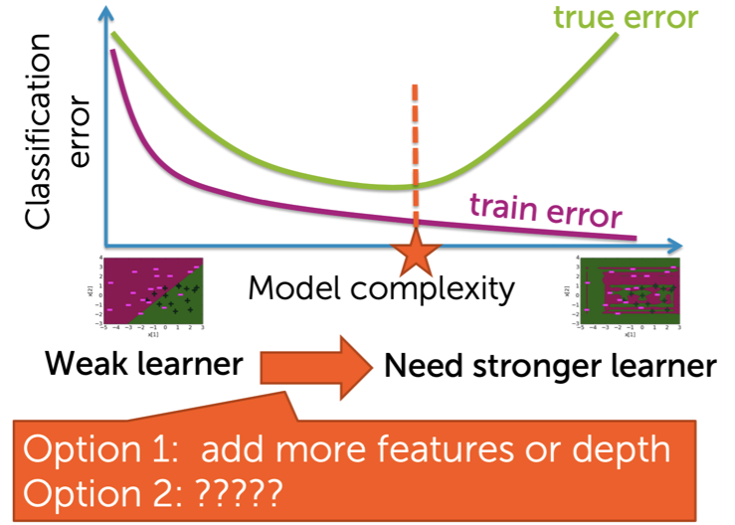
FInding A Classifier That’s Just Right

Slide 67
Boosting
“Can a set of weak learners be combined to create a stronger learner?” Kearns and Valiant (1988)
Yes! Schapire (1990)
Boosting
Amazing impact: • simple approach • widely used in industry • wins most Kaggle competitions • great systems (e.g., XGBoost)

Slide 68
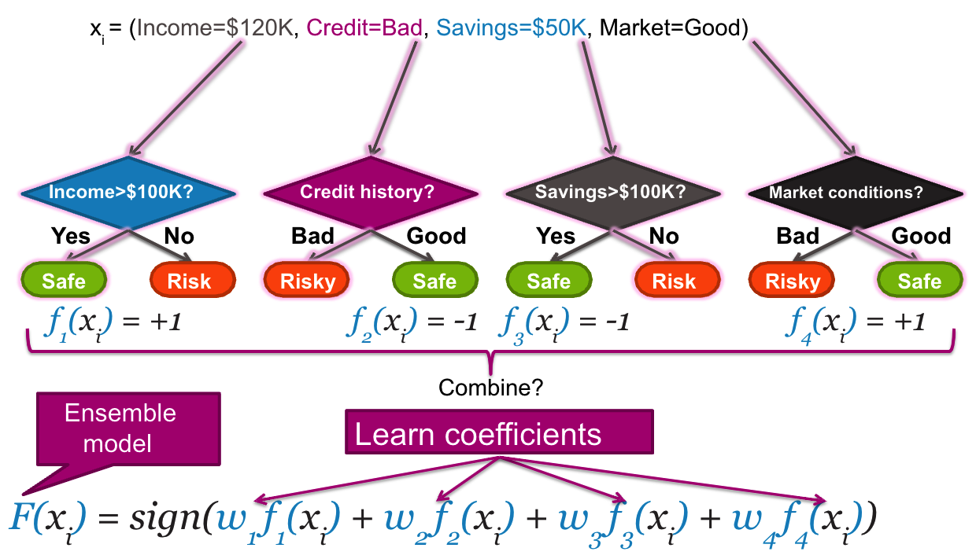
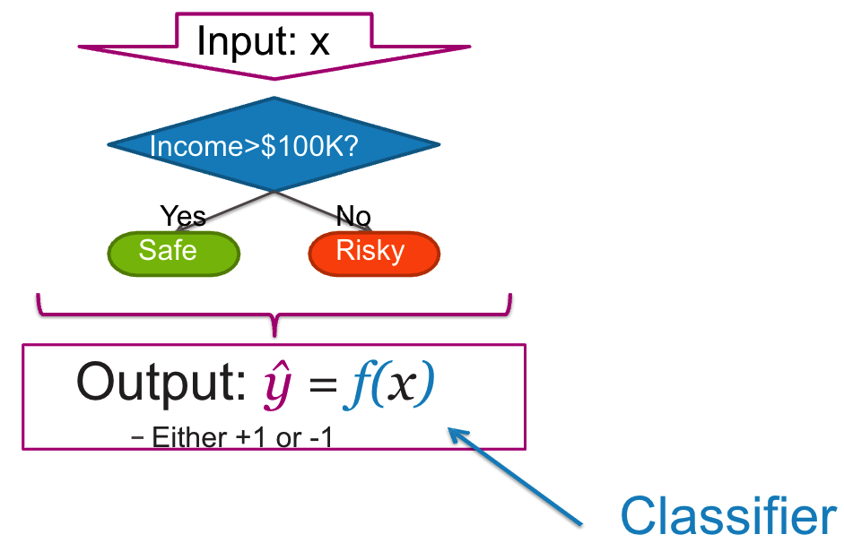
Ensemble Classifier
A single classifier
Ensemble methods: Each classifier “votes” on prediction

Slide 69
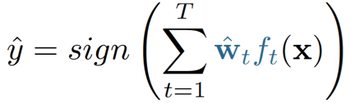
Ensemble Classifier in General
Goal:
Predict output y
Either +1 or -1
From input x
Learn ensemble model:
Classifiers: f₁(x), f₂(x), …, f_{T}(x)
Coefficients: ŵ₁, ŵ₂, …, ŵ_{T}
Prediction:

Slide 70


Training a Classifier
Learn classifier
f(x)
Predict
ŷ = sign(f(x))
Training data

Slide 71


Learning Decision Stump
Credit | Income | y
A | $130K | Safe
B | $80K | Risky
C | $110K | Risky
A | $110K | Safe
A | $90K | Safe
B | $120K | Safe
C | $30K | Risky
C | $60K | Risky
B | $95K | Safe
A | $60K | Safe
A | $98K | Safe
Credit
Income
y
A
$130K
Safe
Income?
B
$80K
Risky
C
$110K
Risky
A
$110K
Safe
> $100K
3 1
A
$90K
Safe
≤ $100K
4 3
B
$120K
Safe
C
$30K
Risky
C
$60K
Risky
B
$95K
Safe
A
$60K
Safe
ŷ = Safe
ŷ = Safe
A
$98K
Safe

Slide 72


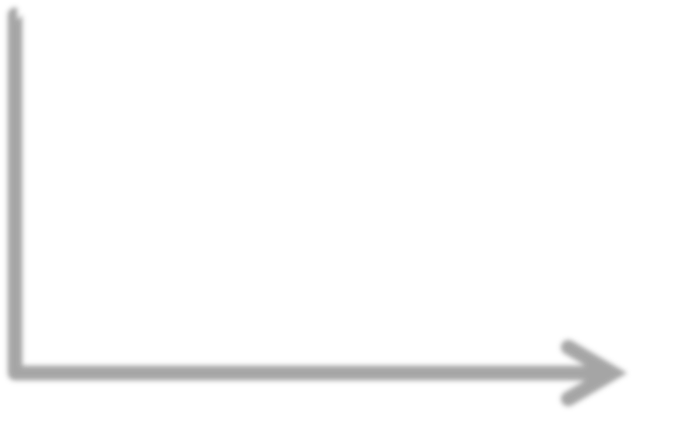

Boosting = Focus Learning on “Hard” Points
Learn classifier
f(x)
Predict
ŷ = sign(f(x))
Training data
Evaluate
Boosting: focus next classifier on places where f(x) does less well
Learn where f(x)
makes mistakes

Slide 73
Learning on Weighted Data:
More weight on “hard” or more important points
Weighted dataset:
Each x_{i}, y_{i} weighted by α_{i}
More important point = higher weight α_{i}
Learning:
Data point i counts as α_{i} data points
E.g., α_{i} = 2 → count point twice

Slide 74


Learning a Decision Stump on Weighted Data
Increase weight α of harder/misclassified points
Credit | Income | y | Weight α
A | $130K | Safe | 0.5
B | $80K | Risky | 1.5
C | $110K | Risky | 1.2
A | $110K | Safe | 0.8
A | $90K | Safe | 0.6
B | $120K | Safe | 0.7
C | $30K | Risky | 3
C | $60K | Risky | 2
B | $95K | Safe | 0.8
A | $60K | Safe | 0.7
A | $98K | Safe | 0.9
Income?
> $100K
2 1.2
≤ $100K
3 6.5
ŷ = Safe
ŷ = Risky

Slide 75






Boosting = Greedy Learning Ensembles from Data
Training data
Learn classifier
Higher weight for points where f₁(x) is wrong
f₁(x)
Predict ŷ = sign(f₁(x))
Weighted data
Learn classifier & coefficient
ŵ,f₂(x)
Predict ŷ = sign(ŵ₁ f₁(x) + ŵ₂ f₂(x))

Slide 76
AdaBoost Algorithm

Slide 77
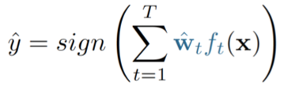
AdaBoost: learning ensemble [Freund & Schapire 1999]
Start with same weight for all points: α_{i} = 1/N
For t = 1,…,T
Learn f_{t}(x) with data weights α_{i}
Compute coefficient ŵ_{t}
Recompute weights α_{i}
Final model predicts by:

Slide 78
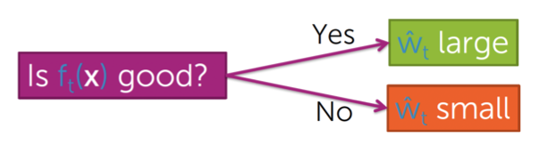
AdaBoost: Computing coefficient ŵ_{t} of classifier f_{t}(x)
f_{t}(x) is good → f_{t} has low training error
Measuring error in weighted data?
- Just weighted # of misclassified points

Slide 79
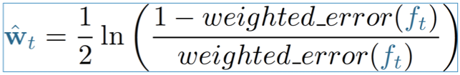
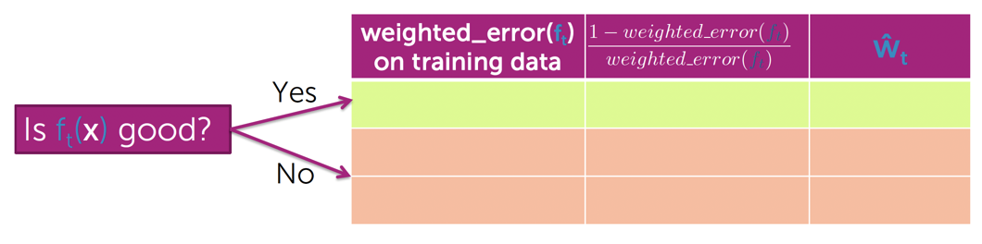
AdaBoost: Formula for computing coefficient ŵ_{t} of classifier f_{t}(x)

Slide 80
AdaBoost: Learning Ensemble
Start with same weight for all points: α_{i} = 1/N
For t = 1,…,T
Learn f_{t}(x) with data weights αi
Compute coefficient ŵ_{t}
Recompute weights α_{i}
Final model predicts by:

Slide 81
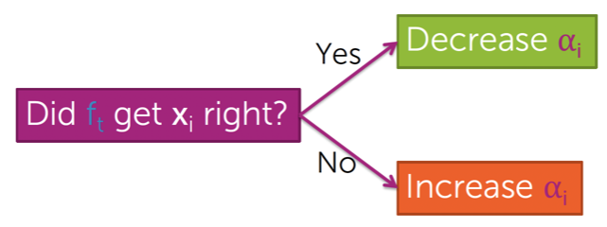
AdaBoost: Updating weights α_{i} based on where classifier f_{t}(x) makes mistakes

Slide 82
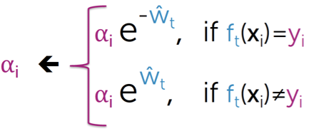
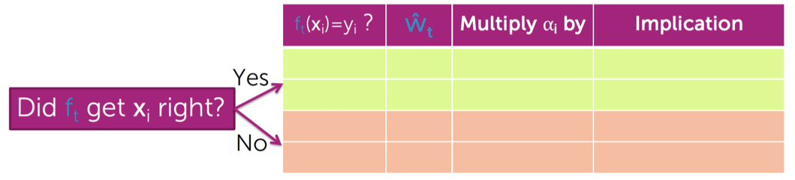
AdaBoost: Formula for Updating Weights α_{i}

Slide 83
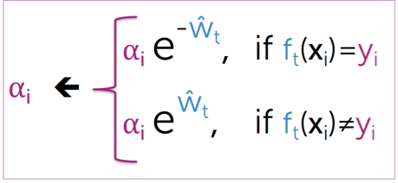
AdaBoost: Learning Ensemble
Start with same weight for all points: α_{i} = 1/N
For t = 1,…,T
Learn f_{t}(x) with data weights αi
Compute coefficient ŵ_{t}
Recompute weights α_{i}
Final model predicts by:

Slide 84
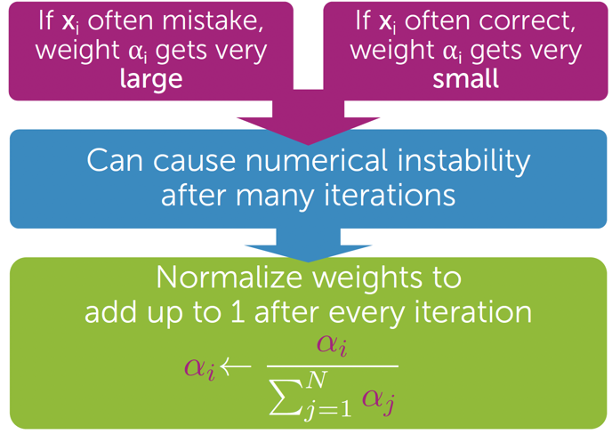
AdaBoost: Normalizing Weights α_{i}

Slide 85
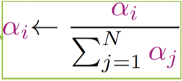
AdaBoost: Learning Ensemble
Start with same weight for all points: α_{i} = 1/N
For t = 1,…,T
Learn f_{t}(x) with data weights αi
Compute coefficient ŵ_{t}
Recompute weights α_{i}
Normalize weights α_{i}
Final model predicts by:

Slide 86
AdaBoost Example: A Visualization

Slide 87
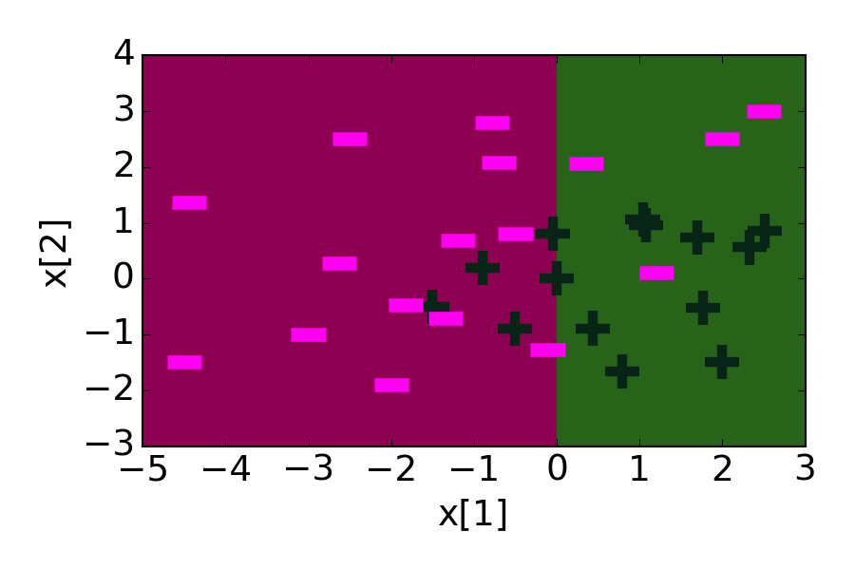
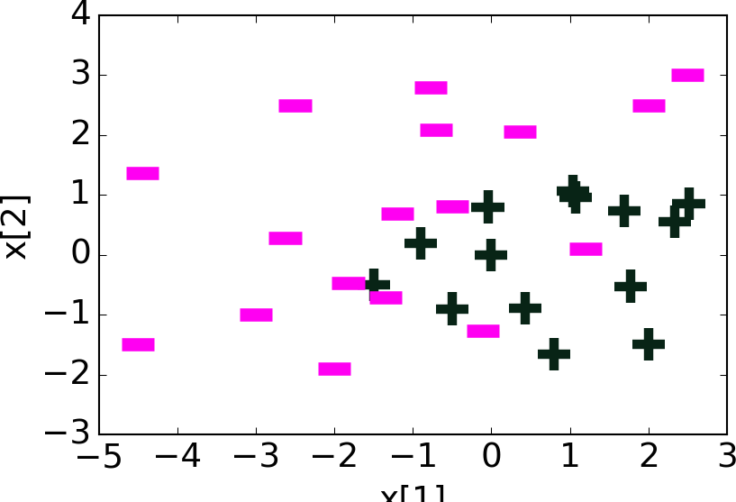
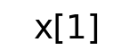
t=1: Just Learn a Classifier on Original Data
Original data
Learned Decision Stump f₁(x)

Slide 88
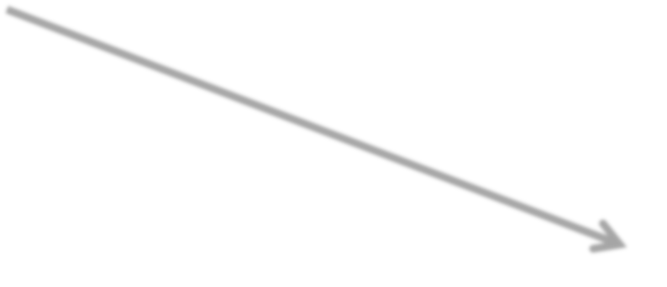
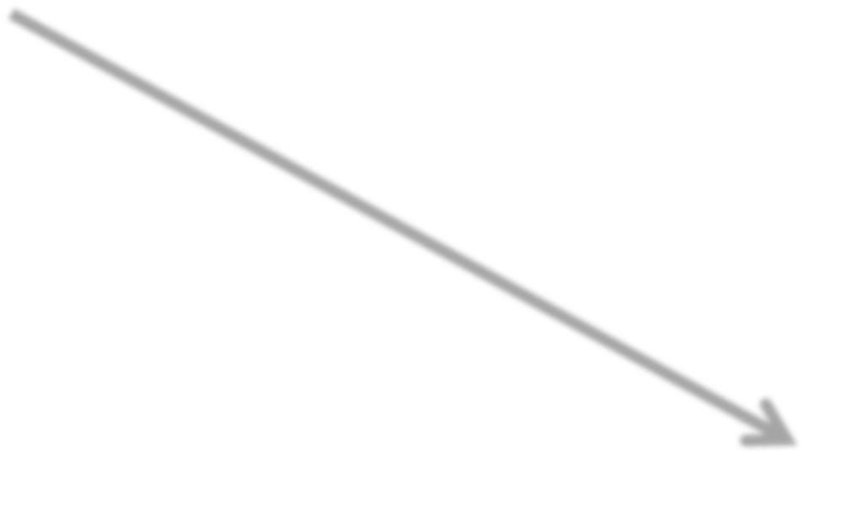
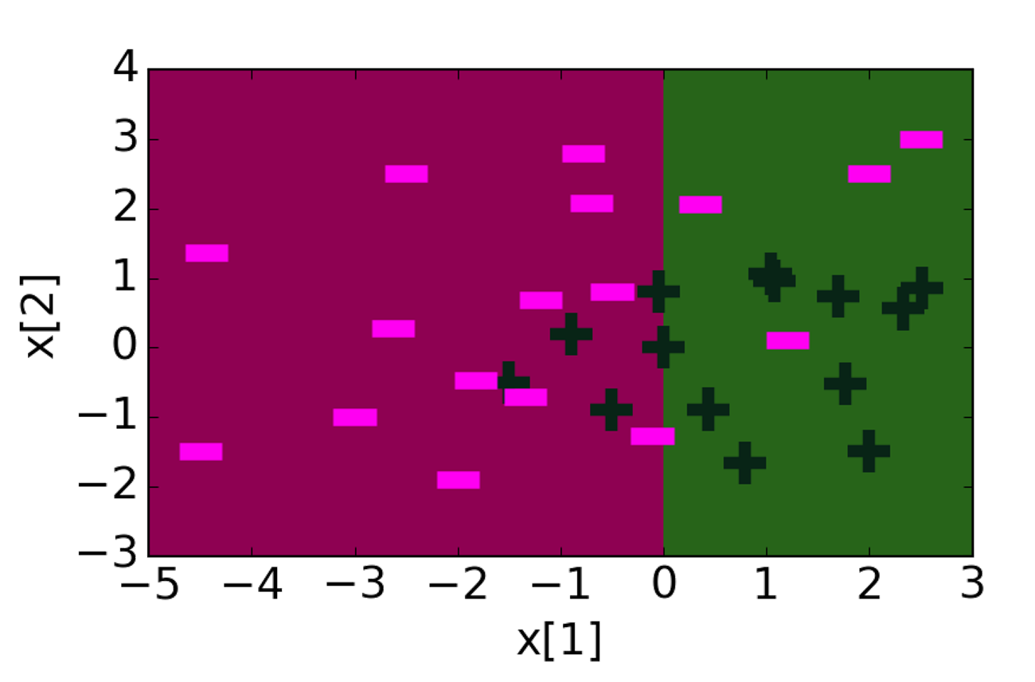

Updating Weights α_{i}
Increase weight α_{i}
of misclassified points
Learned decision stump f₁(x)
New data weights α_{i}
Boundary

Slide 89

t=2: Learn Classifier on Weighted Data

Slide 90







Ensemble Becomes Weighted Sum of Learned Classifiers
ŵ₁
0.61
f₁(x)
ŵ₂
+ ^{0.53}
f₂(x)
=

Slide 91

Decision Boundary of Ensemble Classifier after 30 Iterations
training_error = 0

Slide 92
Boosting Convergence & Overfitting

Slide 93

After Some Iterations, Training Error of Boosting Goes to Zero!!!

Slide 94

AdaBoost Theorem

Slide 95

Condition of AdaBoost Theorem

Slide 96

AdaBoost Theorem More Formally

Slide 97

AdaBoost Theorem More Formally

Slide 98

AdaBoost Theorem More Formally

Slide 99

AdaBoost Theorem More Formally

Slide 100


Decision trees on loan data
39% test error
Overfitting
8% training error
Boosted decision stumps on loan data
32% test error
Better fit & lower test error
28.5% training error

Slide 101


Boosting Tends to Be Robust to Overfitting
Test set performance about constant for many iterations → Less sensitive to choice of T

Slide 102

But boosting will eventually overfit, so must choose max number of components T
Best test error around 31%
Test error eventually increases to 33% (overfits)

Slide 103

Summary of Boosting

Slide 104

Impact of Boosting (Spoiler Alert... HUGE IMPACT)

Slide 105
What You Can Do Now…
Identify notion ensemble classifiers
Formalize ensembles as weighted combination of simpler classifiers
Outline the boosting framework – sequentially learn classifiers on weighted data
Describe the AdaBoost algorithm
Learn each classifier on weighted data
Compute coefficient of classifier
Recompute data weights
Normalize weights
Implement AdaBoost to create an ensemble of decision stumps

Slide 106
Support Vector Machine

Slide 107


Motive: Linear Classification
(𝑤∗)^{𝑇}𝑥 = 0
(𝑤∗)^{𝑇}𝑥 > 0
_{𝑤}∗
(𝑤∗)^{𝑇}𝑥 < 0
Class +1
Class -1
Assume perfect separation between the two classes

Slide 108
Motive: Multiple Optimal Solutions?
(𝑤∗)^{𝑇}𝑥 > 0
(𝑤∗)^{𝑇}𝑥 < 0
Class +1
𝑤₁ 𝑤₂ 𝑤₃
Class -1
Same on empirical loss; Different on test/expected loss

Slide 109
What about 𝑤₁?
New test data
(𝑤∗)^{𝑇}𝑥 > 0
(𝑤∗)^{𝑇}𝑥 < 0
Class +1
𝑤₁
Class -1
Same on empirical loss; Different on test/expected loss

Slide 110
What about 𝑤₃?
New test data
(𝑤∗)^{𝑇}𝑥 > 0
(𝑤∗)^{𝑇}𝑥 < 0
Class +1
𝑤₃
Class -1
Same on empirical loss; Different on test/expected loss

Slide 111
Most confident: 𝑤₂
New test data
(𝑤∗)^{𝑇}𝑥 > 0
(𝑤∗)^{𝑇}𝑥 < 0
Class +1
𝑤₂
Class -1
Same on empirical loss; Different on test/expected loss

Slide 112
Intuition: Margin
(𝑤∗)^{𝑇}𝑥 > 0
large margin
1 / ||w||₂
(𝑤∗)^{𝑇}𝑥 > 0
(𝑤∗)^{𝑇}𝑥 < 0
Class +1
𝑤₂
Class -1
Same on empirical loss; Different on test/expected loss

Slide 113
Intuition: Margin
(𝑤∗)^{𝑇}𝑥 = 1
large margin
1 / ||w||₂
(𝑤∗)^{𝑇}𝑥 = -1
Class y=+1
𝑤₂
(𝑤∗)^{𝑇}𝑥 > 0
Class y=-1
(𝑤∗)^{𝑇}𝑥 < 0
Same on empirical loss; Different on test/expected loss

Slide 114


SVM: Geometric Margin
Given a set of training examples {(x_{i}, y_{i})}^{n}_{i=1}
A linear classifier will be (𝑤∗)^{𝑇}𝑥 = 0
We define functional margin of w with respect to a training example (x_{i}, y_{i}) as the distance from the point (x_{i}, y_{i}) to the decision boundary, which is

Slide 115


Maximum Margin Classifier
We propose the following optimization problem, maximize the margin.
This is hard to do:
maximize the numerator
minimize the denominator
How about we just try to do this if we assume γ is a lower bound on the margin?

Slide 116




Maximum Margin Classifier
Still hard to optimize, so we reparameterization if we condition the numerator is >=1:
Conditioning on
So we can see we want to maximize , which is minimize
This is is a quadratic problem with linear constraints, easy to solve

Slide 117


Don’t Forget It’s Still a Classifier
We want to have a loss function that conditioning on the
So the overall SVM algorithm is try to optimize:

